Slide 1

AI for Snake Game using Reinforcement Learning
Presented by,
Harinath Talluri(00865329)
Abhinay Reddy Musuku(00858095)
Madhava Naidu Valluru(00884651)

Slide 2
Project Topic
Project Title: Developing an AI Agent to Play Snake
“I hypothesize that reinforcement learning models, specifically Q-learning and Deep Q-Networks (DQN), can improve the performance and survival of a Snake AI player by maximizing score and minimizing collisions.”
Create an AI agent that learns to play the classic Snake game.

Slide 3
Project Objectives
Primary Objectives : Teach AI to Play Snake: Enable the AI to learn and improve its gameplay through reinforcement learning.
Maximize Score: Develop strategies that allow the AI to grow the snake by efficiently collecting food.
Ensure Survival: Minimize the likelihood of collisions with itself and the game boundaries.
Secondary Objectives : Understand Reinforcement Learning: Gain practical knowledge of reinforcement learning concepts through implementation.
Enhance Problem-Solving Skills: Tackle challenges related to game state representation, reward structure, and learning algorithms.

Slide 4
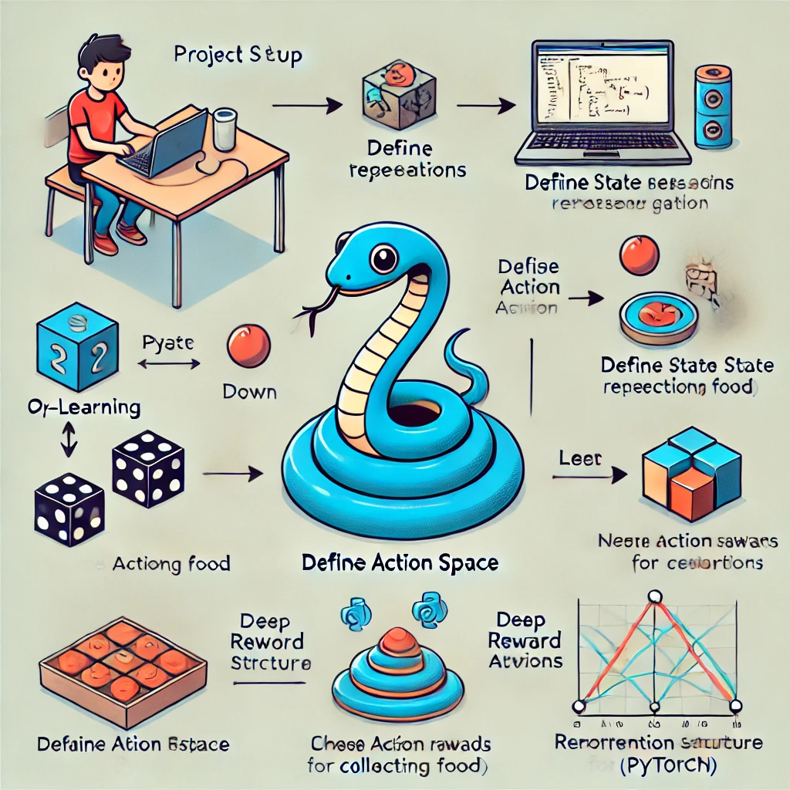
Approach
Tools:
Programming Language: Python
Libraries:
Pygame : Use this library to create the game environment, handle graphics, and manage game interactions.
PyTorch : Implement reinforcement learning algorithms using PyTorch to build and train the AI agent.
GitHub for version control and progress tracking.
Techniques:
Reinforcement Learning Techniques:
State Representation: Define the game state (snake position, direction, food location).
Action Space: Allow AI to move in four directions: up, down, left, and right.
Reward Structure: Create a reward system to encourage food collection and discourage collisions.
Learning Algorithm: Choose a suitable algorithm (e.g., Q-learning or Deep Q-Networks) for the training process.

Slide 5
Deliverables
AI Agent Model: A fully trained reinforcement learning agent capable of playing Snake.
Game Implementation: A functioning Snake game developed in Pygame that showcases the AI's gameplay.
Documentation:
Technical setup guide for running the game and AI model.
Description of the learning algorithms used and their implementation details.
Demo Presentation: A demonstration of the AI agent playing Snake, highlighting its learning progress and strategies.
Evaluation Report: An analysis of the AI's performance, including metrics on score, survival time, and learning efficiency.

Slide 6
Evaluation Methodology
Performance Metrics:
Score Tracking: Monitor the AI's score to evaluate its ability to collect food and grow.
Survival Duration: Measure how long the AI can avoid collisions and survive in the game.
Learning Curve: Analyze the AI’s improvement over time, assessing the effectiveness of
the reinforcement learning algorithm such that Improvement in performance over episodes,
tracking metrics like cumulative reward and average survival time.

Slide 7
Thank You

